Slide 1




TEAM NUANCE - SALES DATA ANALYSIS
JILLIAN NEMEC
KAYLA MACAIONE
ERIC MEDINA
AMUSA ADEBAYO

Slide 2
QUESTIONS & MOTIVATION
Analyze Sales Data from Nuance Solutions from 2019-2020 to identify sales trends in relation to:
What are the top Customer Silos?
How are the sales distributed by Silo in 2019 vs 2020?
What are the top product categories within the Silos?
How do the sales by product category vary over time?
What are the top products sold within the product categories by quantity?
What are the top products and who are the customers purchasing them?
How do the top products compare to the date they were invented?
Team Nuance chose to analyze sales trends for Nuance Solutions because we were interested in sales trends and Nuance Solutions encourages education, so they were happy to allow us to use real data for this project.

Slide 3
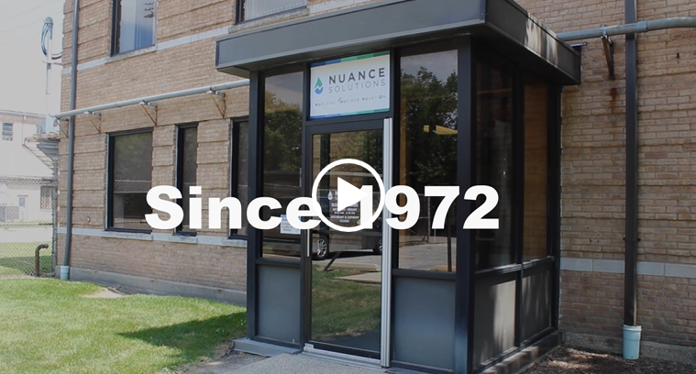
ABOUT NUANCE SOLUTIONS
Nuance Solutions is a chemical development and manufacturing company that’s all about cultivating chemistry in and out of the lab. We’re committed to building lifelong, trusted relationships with our customers in all three of our divisions: NuBlend, NuFiber, and NuVation.
NuBlend is our industrial cleaning product line focusing on super concentrated chemistries and advanced dispensing systems.
NuFiber houses our microfiber technology, which includes a broad range of cleaning products and systems that exponentially increase the effectiveness of sanitation and commercial cleaning.
NuVation is where our research and development team shine, using their expertise to create new chemistries.
Our Mission “Providing creative solutions for our customers. People and products you can count on.”
Our Vision “Create chemistry that bonds our people and serves our customers.”

Slide 4
DEFINITIONS
SILOS – Identifies the customer type
JanSan (Janitorial) Customers who typically purchase NuFiber, air fresheners or odor counteractive, multipurpose cleaner and more.
Industrial Customers purchase items in our NuBlend division such as degreaser, lubricants, and concentrated cleaners.
Contract and Specialty Customers are customers who come to Nuance to create a product that they want to make but do not have the expertise to formulate or capacity to manufacture.
Contract and Specialty Customers fall into the NuVation division.
PRODUCT CATEGORIES – Identifies the type of product manufactured

Slide 5
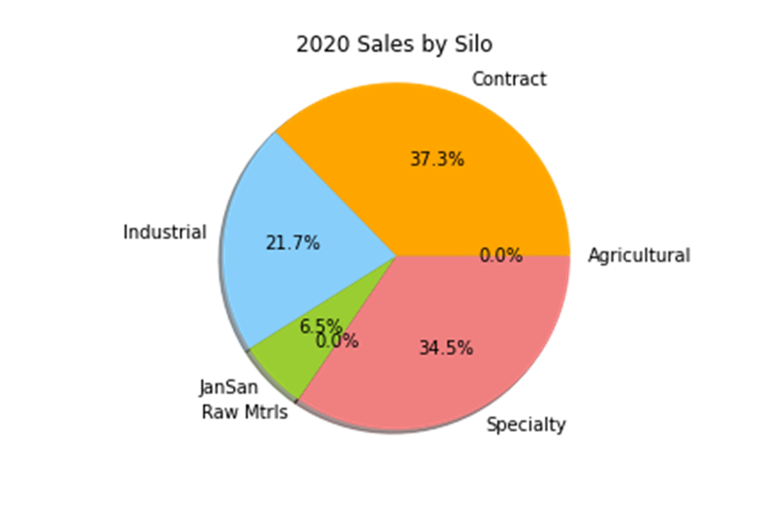
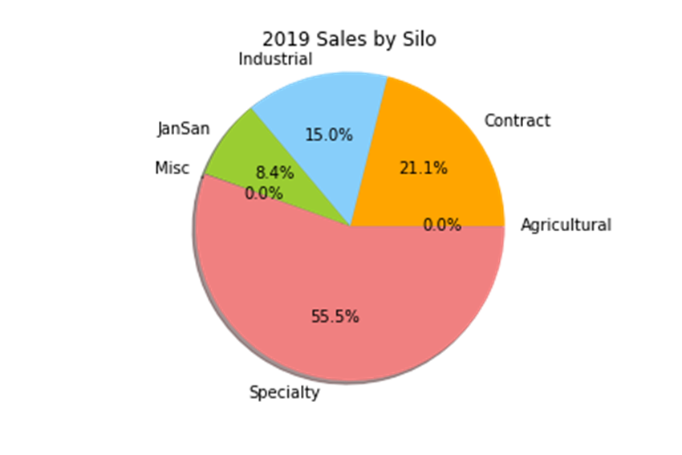
SALES BY SILO

Slide 6
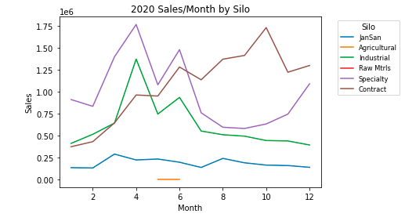
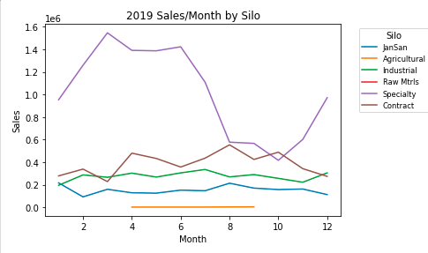
SALES BY SILO OVER TIME

Slide 7
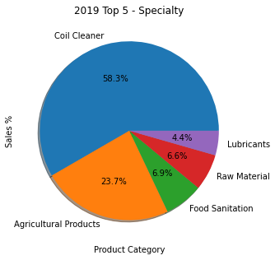
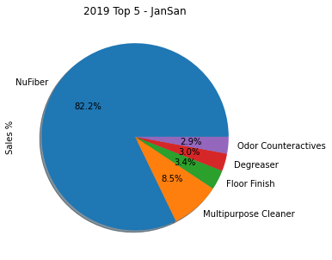
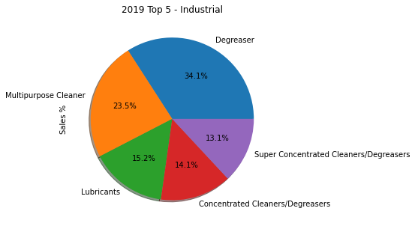
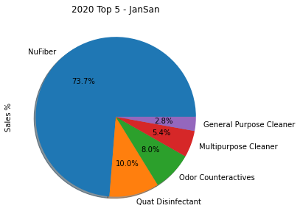
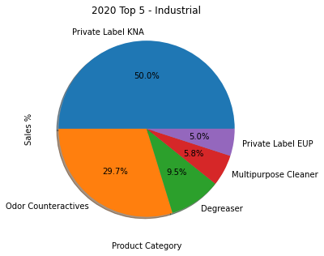
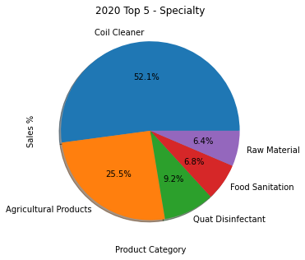
TOP 5 PRODUCT CATEGORIES BY SILO

Slide 8
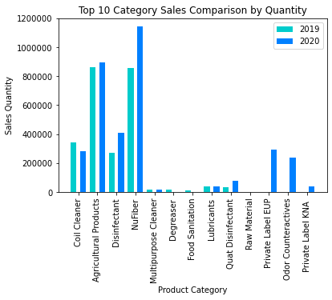
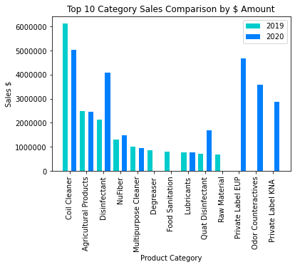
Sales by Category Yearly Comparisons

Slide 9
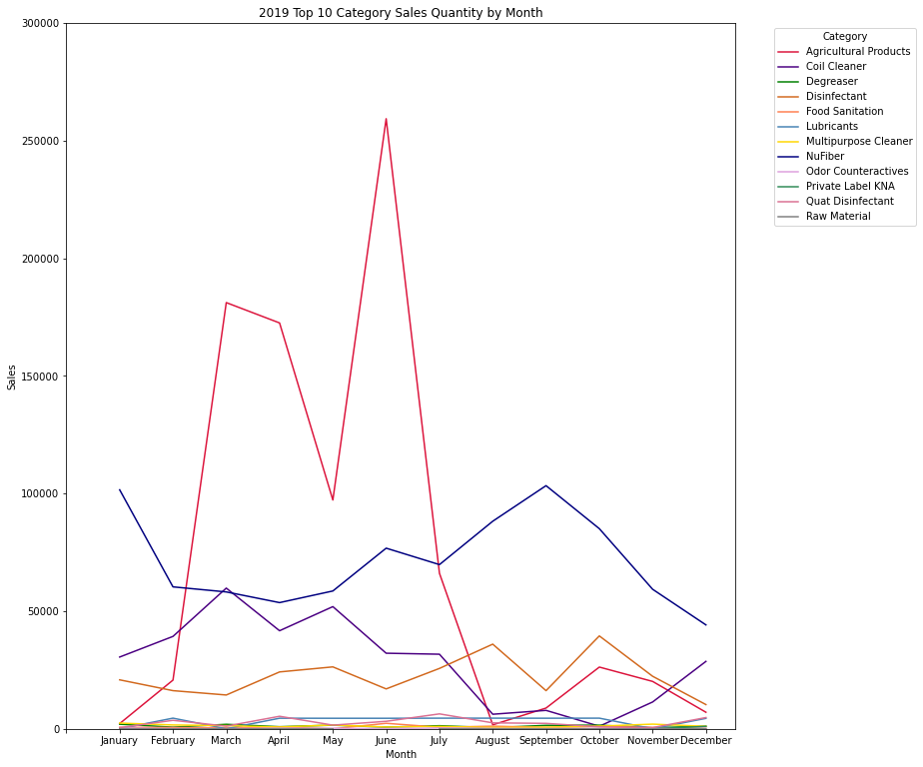
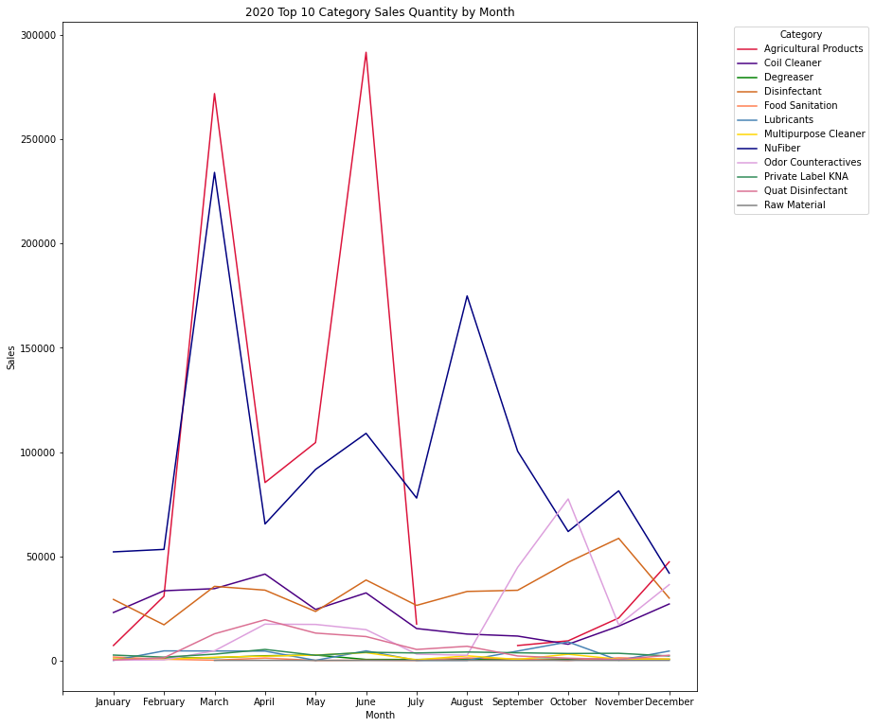
Sales Comparison by Category Quantity

Slide 10
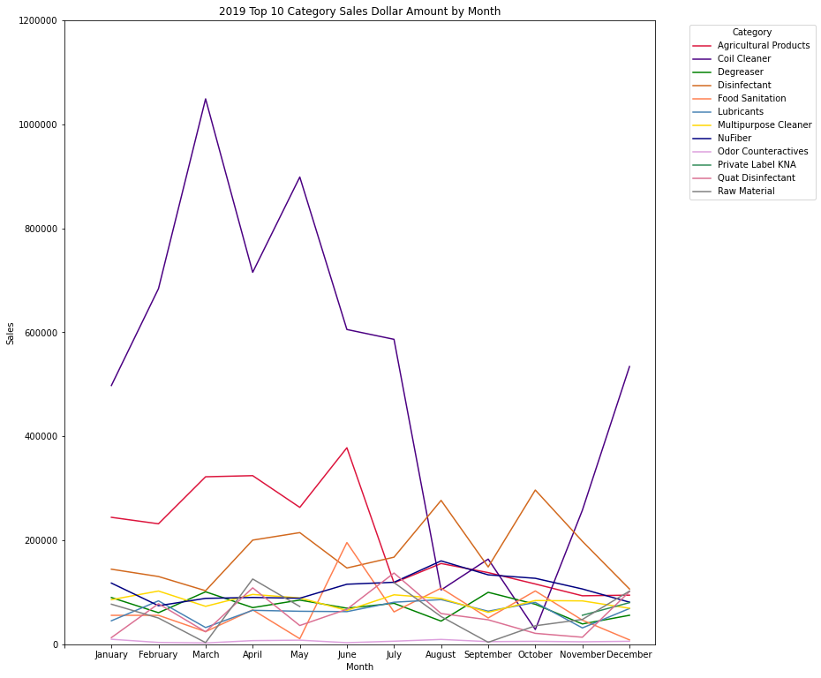
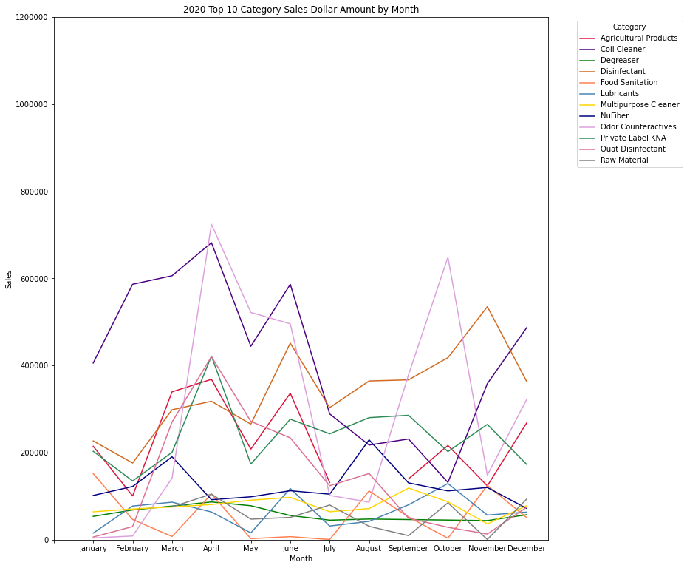
Sales Comparison by Category Dollar Amount

Slide 11
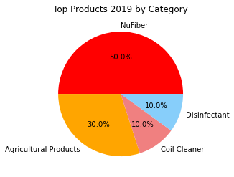
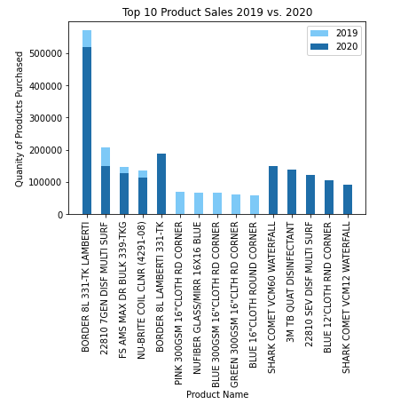
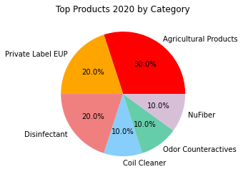
Top Items

Slide 12
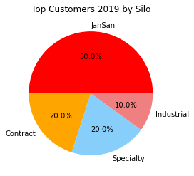
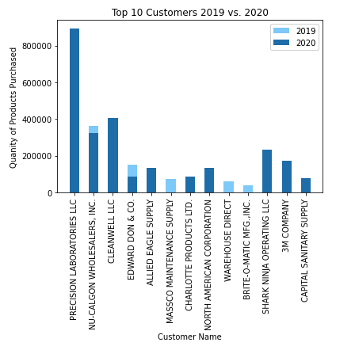
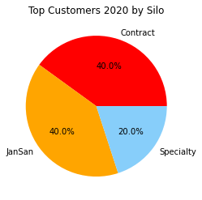
Top Customers by Quantity

Slide 13
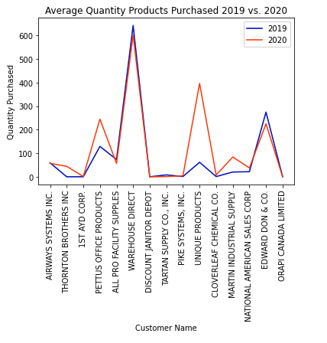
Customer Name | Silo
Airways Systems Inc. | Industrial
Thornton Brothers Inc. | Industrial
1st AYD Corp. | Industrial
Pettus Office Products | JanSan
All Pro Facility Supplies | JanSan
Warehouse Direct | JanSan
Discount Janitor Depot | Industrial
Tartan Supply Co., Inc. | Industrial
Pike Systems, Inc. | JanSan
Unique Products | JanSan
Cloverleaf Chemical Co. | Industrial
Martin Industrial Supply | JanSan
National American Sales Corp | JanSan
Edward Don & Co. | JanSan
Orapi Canada Limited | Specialty

Slide 14
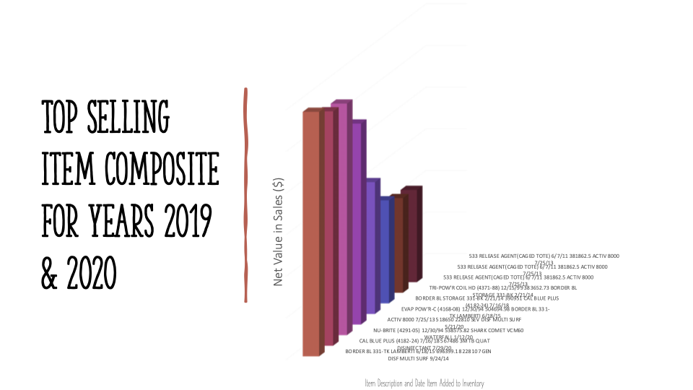
Item Sales vs Date Added Comparisons

Slide 15


Item Sales vs Date Added Comparisons
Item_Descrition | Item_Add_date | qty_ship(2019) | price_net(2019)
NU-BRITE COIL CLNR (4291-08) | 12/30/94 | 135086 | 2154237.7
22810 7GEN DISF MULTI SURF | 9/24/14 | 205989 | 1434360.43
BORDER 8L 331-TK LAMBERTI | 6/18/15 | 570819 | 696399.18
CAL BLUE PLUS (4182-24) | 7/16/18 | 16740 | 567486
NU-BRITE (4291-05) | 12/30/94 | 39514 | 538575.82
ACTIV 8000 | 7/25/13 | 110 | 518650
EVAP POW'R-C (4168-08) | 12/30/94 | 29394 | 504694.98
BORDER 8L STORAGE 331-BK | 2/21/14 | 1077 | 390951
TRI-POW'R COIL HD (4371-88) | 12/15/99 | 24899 | 383652.73
533 RELEASE AGENT(CAGED TOTE) | 6/7/11 | 425 | 381862.5
Item_Descrition | Item_Add_date | Qty_shiped (2020) | Sale_net(2020)
SHARK COMET VCM12 WATERFALL | 1/12/20 | 90190 | 2931175
NU-BRITE COIL CLNR (4291-08) | 12/30/94 | 114768 | 1825958.88
22810 7GEN DISF MULTI SURF | 9/24/14 | 148560 | 1175026.38
3M TB QUAT DISINFECTANT | 7/29/20 | 137873 | 1126422.41
SHARK COMET VCM60 WATERFALL | 1/12/20 | 149567 | 1112778.82
22810 SEV DISF MULTI SURF | 5/21/20 | 121394 | 965766.16
BORDER 8L 331-TK LAMBERTI | 6/18/15 | 519108 | 633311.76
CAL BLUE PLUS (4182-24) | 7/16/18 | 14587 | 494963.58
BORDER 8L STORAGE 331-BK | 2/21/14 | 1245 | 454863.75
ACTIV 8000 | 7/25/13 | 94 | 443210

Slide 16

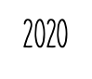

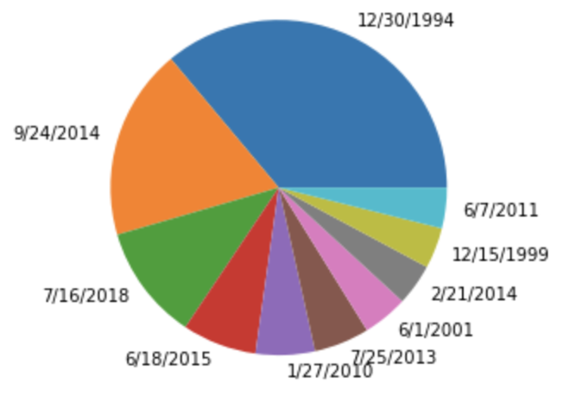

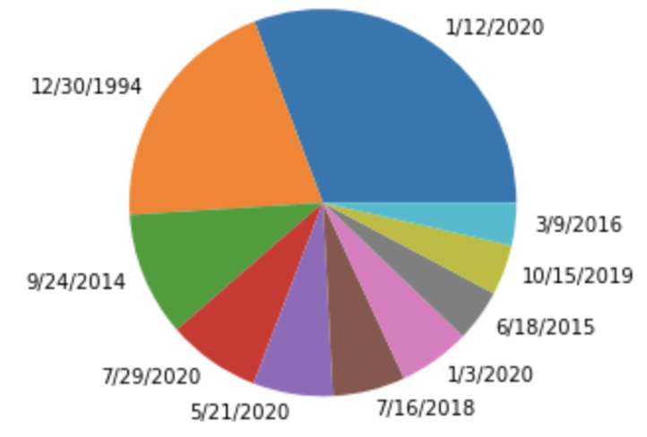
SALES VALUE (price_net) BY DATE PRODUCT ADDED

Slide 17
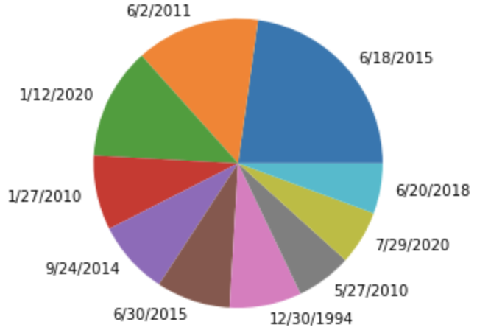
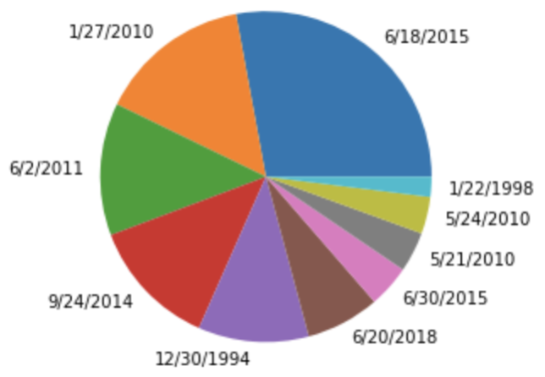


QUANTITY SHIPPED BY DATE PRODUCT ADDED

Slide 18
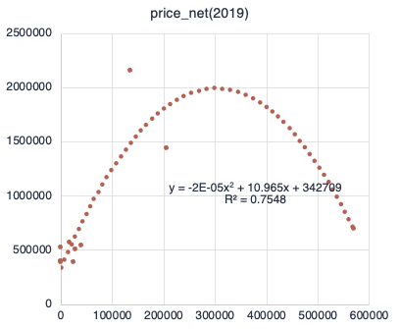
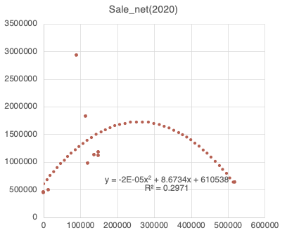
Regression of NET_PrICE on Quantity Shipped

Slide 19
Regression of Sales revenue on Quantity shipped (2019 & 2020)
MODEL R^2 | 2019 | 2020
Polynomial | 0.7548 | 0.2971
Linear | 0.0809 | 0.0006
Exponential | 0.1536 | 0.0059
Logarithmic | 0.264 | 0.1824
Power | 0.3495 | 0.3673

Slide 20

Post Mortem
Challenges:
Narrowing down our parameters to a reasonable project that we could handle as beginning coders.
Determining the type of plots that told a story based on the specific breakdown.
Finding code that worked for the type of output we wanted (i.e. dual graphs on the same plot).
Finding time that worked for all of us to get together outside of class.
Additional Questions:
How did COVID effect the sales trends?
We did not have enough time to parse through the large datasets of COVID numbers in order to compare the rates for each month to our data.

Slide 21
CONCLUSIONS
The top customers by Silo are consistently Specialty, Contract, and Industrial
2020 saw a significant increase in business for all Silos, most noticeably in the Contract Silo
Disinfectants became a top product category across all Silos in 2020
NuFiber made up 50% of sales by quantity in 2019 but was knocked down to 10% due to more disinfectants, private label brands and new customers sneaking into the top 10
On average, Janitorial customers purchased more products by quantity in 2020 than they did in 2019
Overall sales for each category seemed to increase from 2019 to 2020.
Disinfectant sales increased by almost double from 2019 to 2020.
SHARK COMET VCM12 WATERFALL added 1/12/20 dominated sales value
NU-BRITE COIL CLNR (4291-08) added 12/30/94 is the oldest item with highest sales value
The volume of sales and dollar values suggest an impact of Covid-19 on sale drive across the past 2 years

Slide 22
Q&A

